Slide 1


DSA0204 –Computer Vision With OpenCV SmartLivestock AI: Automated Animal Disease Detection and Behaviour Analysis Using Vision Transformers
SIMATS ENGINEERING Saveetha Institute of Medical and Technical Sciences Chennai-602105.
Presented By:
S. Krishna Chaithanya (192424287)
G.Gopichand(192424384)
BhuvanKumar j(192524040)
Supervisor:
Dr.G.A.Senthil

Slide 2
ABSTRACT
SmartLivestock AI is a system that helps farmers check the health and behaviour of their animals using AI.
It uses Vision Transformers (ViT) to detect diseases and identify unusual animal behaviour from images and videos.
The system can find health problems early and alert the farmer quickly.
Early detection helps farmers treat animals on time, reducing losses and improving animal health.
This project makes livestock farming easier, smarter, and more efficient.

Slide 3
INTRODUCTION
Livestock farming is important for producing milk, meat, and other animal products. Farmers find it difficult to watch every animal all the time.
Sometimes, diseases and unusual behaviour are not noticed early, which can cause health problems and financial losses.
SmartLivestock AI is an AI-based system that helps farmers monitor their animals automatically.
The system uses Vision Transformers (ViT) to analyze animal images and videos.
It can detect diseases and identify unusual behaviours such as less movement, poor eating, or abnormal posture.
This helps improve animal health, reduce losses, and increase farm productivity.

Slide 4
OBJECTIVES
To detect animal diseases at an early stage using AI.
To monitor animal behaviour using images and videos.
To identify unusual behaviours such as less movement, poor eating, or abnormal posture.
To provide early alerts to farmers when a health problem is detected.
To improve the health and well-being of livestock.
To reduce animal deaths and treatment costs.
To increase farm productivity and efficiency..

Slide 5
LITERATURE SURVEY
S. No. | Year | Author(s) | Method / Technology | Key Findings | Limitations
1 | 2023 | Islam et al. | RGB camera, ultrasonic sensor and deep learning | Automatically detected and analysed the drinking behaviour of beef cattle | Focused only on drinking behaviour and required an additional sensor
2 | 2024 | Saqib et al. | CNN and transfer learning | Detected lumpy skin disease in cattle images with approximately 95% accuracy | Mainly limited to healthy and infected binary classification
3 | 2024 | Qazi et al. | AnimalFormer with GroundingDINO, HQSAM and ViTPose | Recognised sheep behaviours such as grazing, walking, running, standing and sitting | Computationally expensive for low-cost farm devices
4 | 2025 | Zong et al. | Multi-scale deep-learning model | Improved dairy-cow behaviour recognition at different distances and object sizes | Performance can decrease because of occlusion, crowding and poor lighting
5 | 2026 | Ullah et al. | Vision Transformer with a mobile application | Supported early and accurate detection of lumpy skin disease in cattle | Focused on a single disease without continuous behaviour monitoring

Slide 6
PROBLEM STATEMENT
Farmers cannot continuously monitor every animal, especially on large farms.
Manual observation is time-consuming and may lead to human errors.
Diseases are often detected only after they become serious.
Unusual animal behaviour is difficult to identify at an early stage.
Late detection increases treatment costs and reduces productivity.
Farmers need an automated system for continuous monitoring.
AI can help detect diseases and abnormal behaviour quickly..

Slide 7
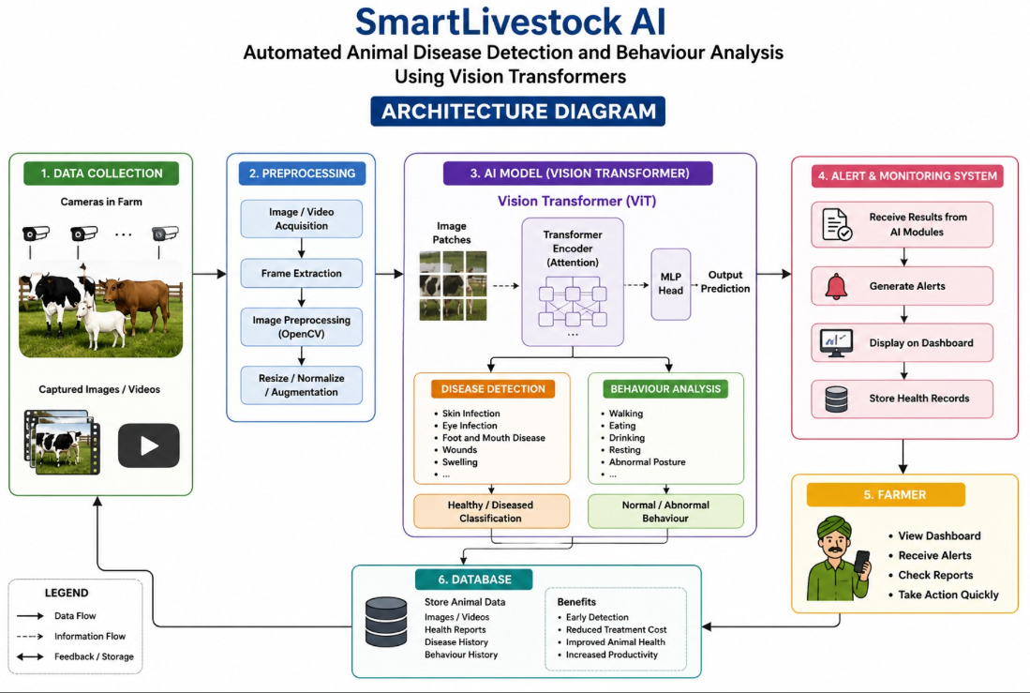
System Archeiture

Slide 8
List Of Modules
Module 1: Animal Disease Detection
Module 2: Animal Behaviour Analysis
Module 3: Alert and Monitoring System

Slide 9
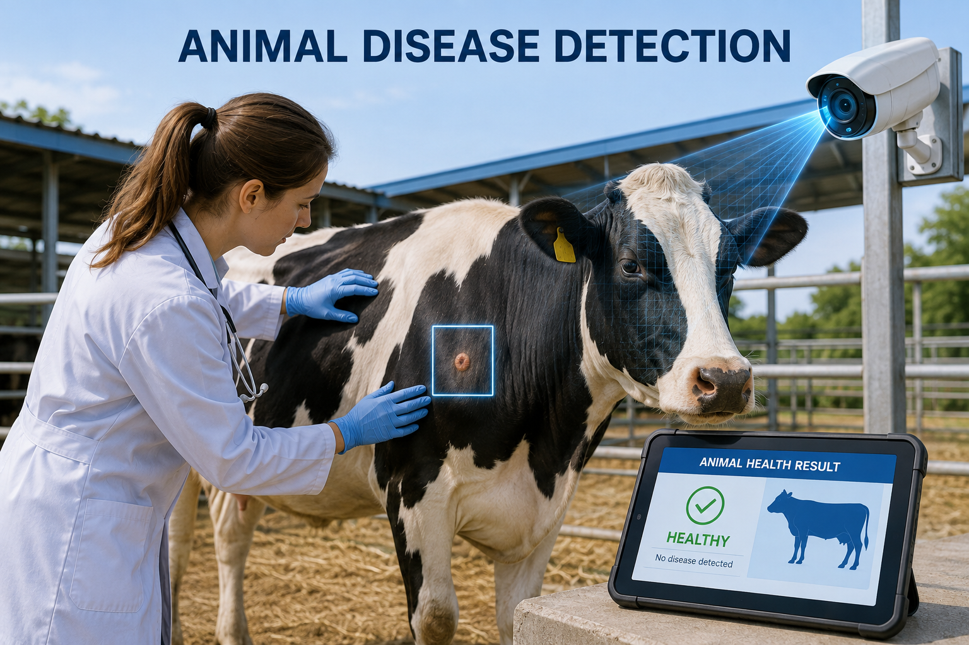
MODULE 1: Animal Disease Detection
Captures animal images and videos using cameras.
Preprocesses the captured images for better analysis.
Uses Vision Transformers (ViT) to analyze animal images.
Detects visible disease symptoms such as wounds, skin infections, swelling, or eye problems.
Identifies whether the animal is healthy or diseased.
Predicts the possible disease based on the detected symptoms.
Generates early alerts when a disease is detected.

Slide 10
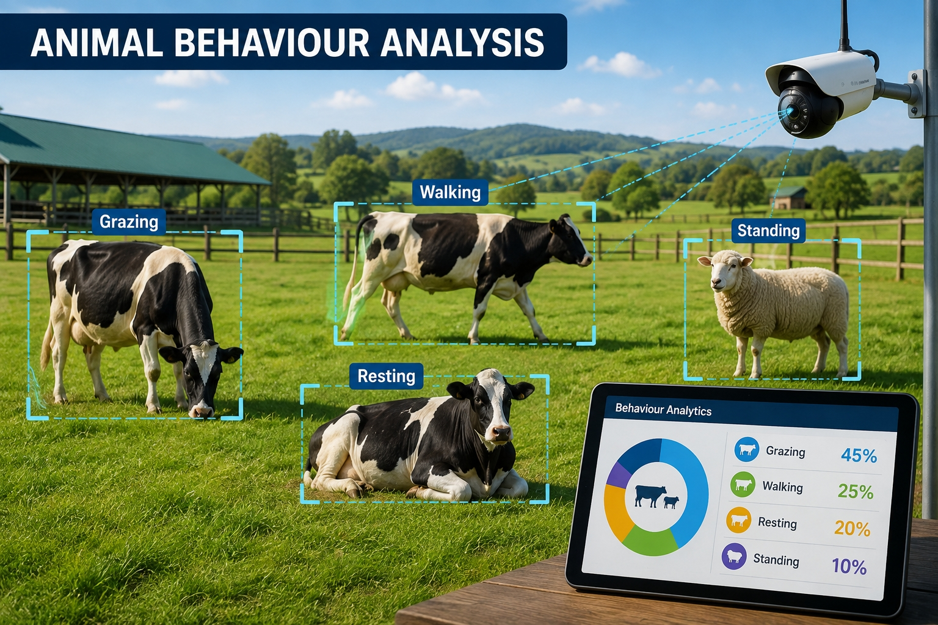
Module 2: Animal Behaviour Analysis
•.
Captures animal movements using cameras.
Monitors daily activities such as walking, eating, drinking, and resting.
Uses Vision Transformers (ViT) to analyze animal behaviour.
Detects unusual behaviours such as less movement, poor feeding, or abnormal posture.
Compares current behaviour with normal behaviour patterns.
Identifies signs of stress, illness, or discomfort. Sends alerts when abnormal behaviour is detected.

Slide 11
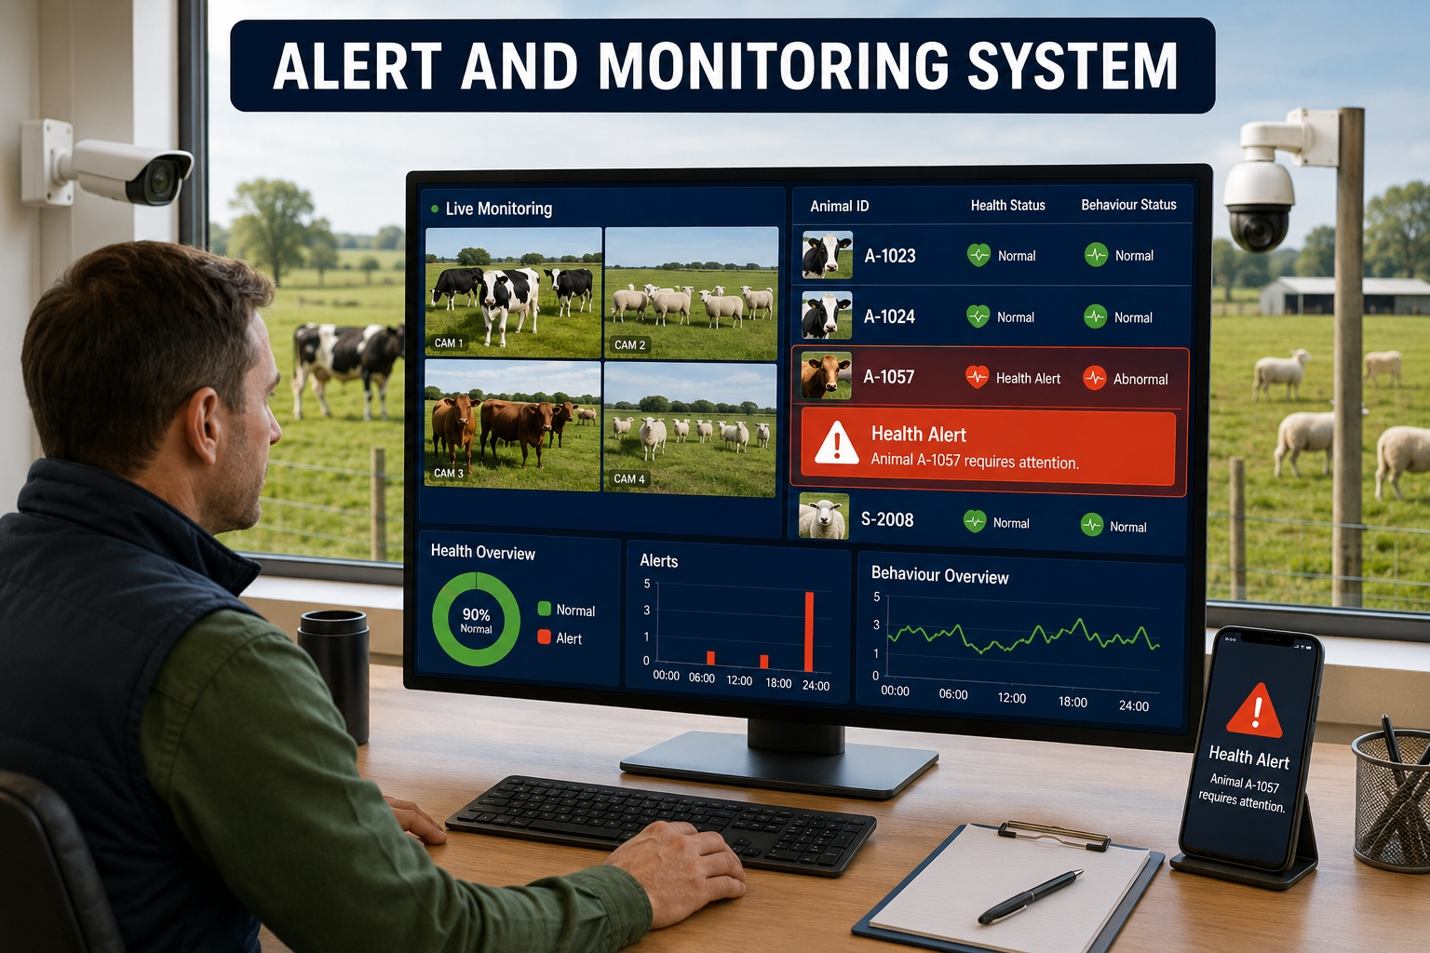
Module 3: Alert and Monitoring System
•.
Receives results from the disease detection and behaviour analysis modules.
Monitors the health status of animals continuously.
Sends instant alerts when a disease or abnormal behaviour is detected.
Displays health reports and monitoring results on a dashboard.
Helps farmers take quick action to treat sick animals.
Stores animal health records for future reference.
Reduces disease spread through early warning.
Improves decision-making with real-time monitoring.

Slide 12
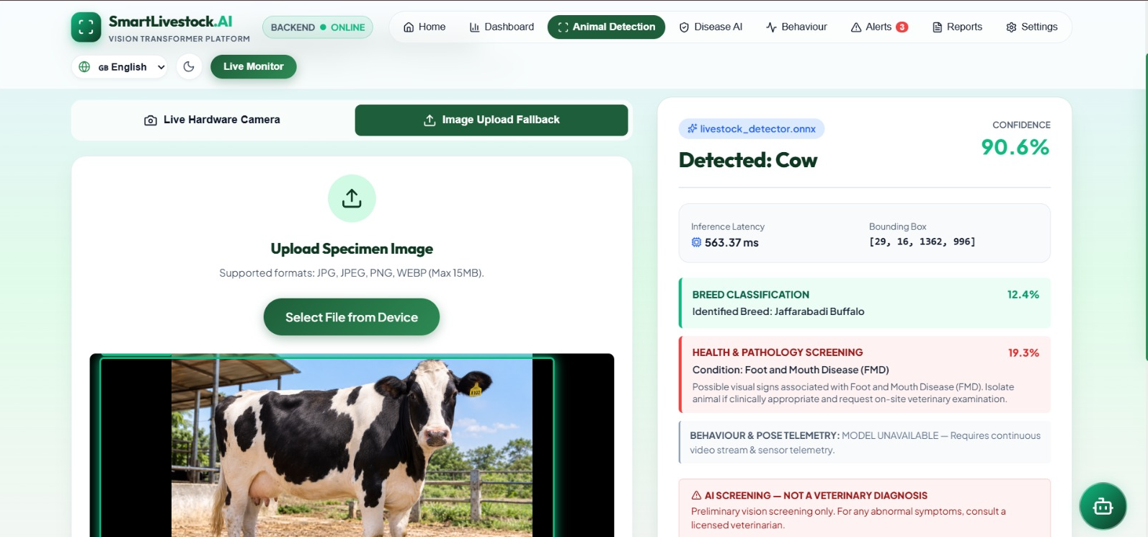
Output

Slide 13
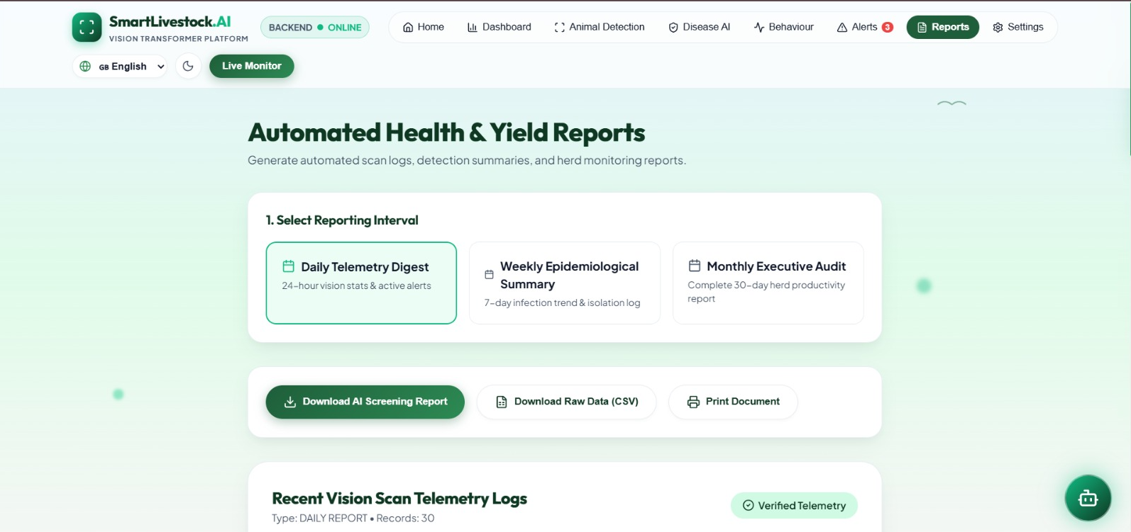
Output

Slide 14
CONCLUSION
SmartLivestock AI provides an intelligent solution for monitoring the health and behaviour of livestock.
The system uses Vision Transformers (ViT) to detect animal diseases and analyze behaviour from images and videos.
It helps identify diseases and unusual behaviour at an early stage.
The alert system notifies farmers immediately, allowing timely treatment and better animal care. Early detection reduces animal losses, treatment costs, and the spread of diseases.
The system improves livestock health, farm productivity, and overall management.
9

Slide 15
Future Scope
Integration of thermal cameras for early detection of fever and inflammation.
Real-time monitoring using drones and smart farm cameras.
Development of mobile applications for instant farmer notifications.
Support for more animals, breeds, diseases, and behaviour categories.
Integration with wearable sensors for improved detection accuracy.
Use of edge computing for faster analysis without constant internet access.
Predictive analytics to identify health problems before visible symptoms appear.

Slide 16
REFERENCES
Dosovitskiy, A., et al. (2021). An Image is Worth 16×16 Words: Transformers for Image Recognition at Scale. International Conference on Learning Representations (ICLR).
Vaswani, A., et al. (2017). Attention Is All You Need. Advances in Neural Information Processing Systems (NeurIPS). Goodfellow, I., Bengio, Y., & Courville, A. (2016).
Deep Learning. MIT Press. Russell, S., & Norvig, P. (2021). Artificial Intelligence: A Modern Approach (4th Edition). Pearson. Zhang, Z., et al. (2023).
Deep Learning-Based Animal Disease Detection Using Computer Vision: A Review. Computers and Electronics in Agriculture.

Slide 17

12

